Slide 1
Self-help on the Internet for affected family members of disordered gamblers – evaluation of a German programme
Prof. Dr. Ursula Buchner

Slide 2
Background
Barriers to seeking help for AFMs like stigma and shame (Kourgiantakis et al., 2017; Hing et al., 2013)
AFMs often do not seek formal or informal support (Landon et al, 2017)
AFMs often prefer low intensity interventions (Hing et al., 2013)
E-Mental Health Programme “Verspiel nicht mein Leben” – Entlastung für Angehörige (EfA) “Don’t gamble away my life” - Support for Affected Others
Notes:
Aims of the programme:
raise awareness for the set of issues that are associated with disordered gambling
provide a first point of access to professional help
give information concerning further professional help to AFM

Slide 3
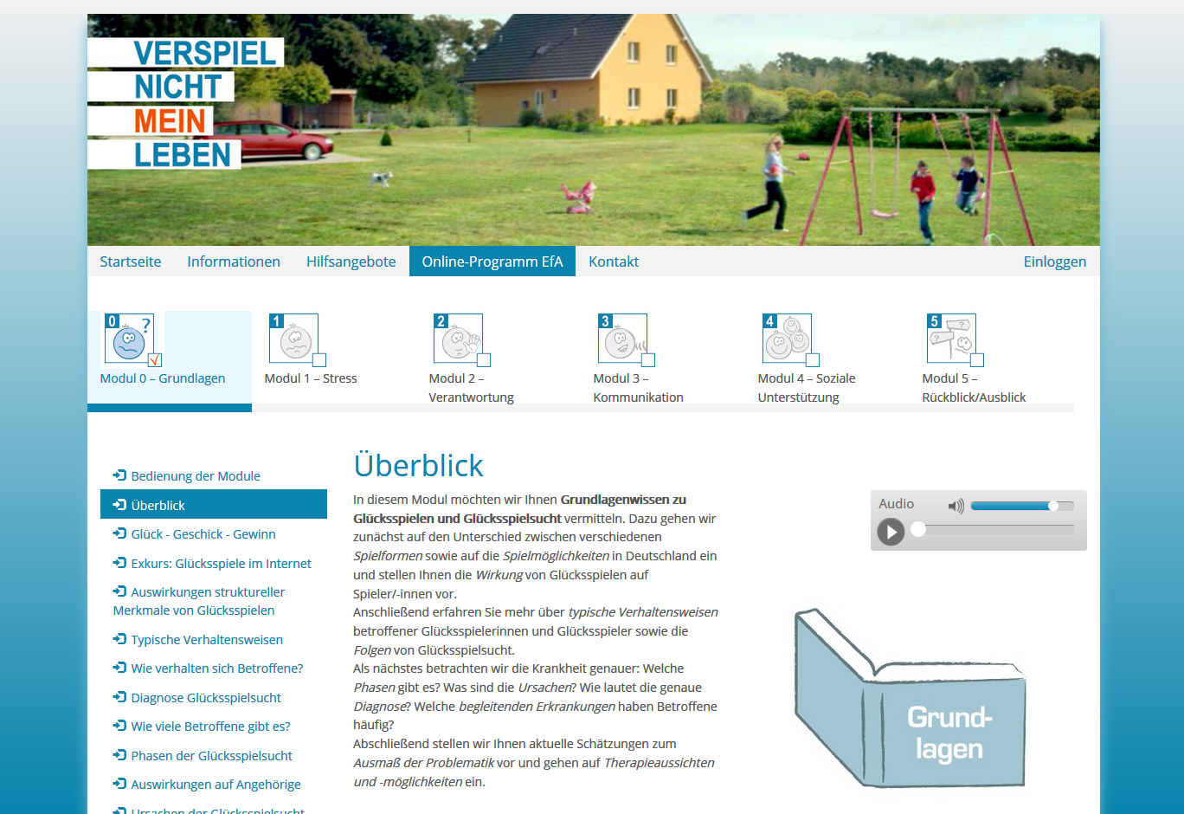
www.verspiel-nicht-mein-leben.de [Don‘t gamble away my life]

Slide 4
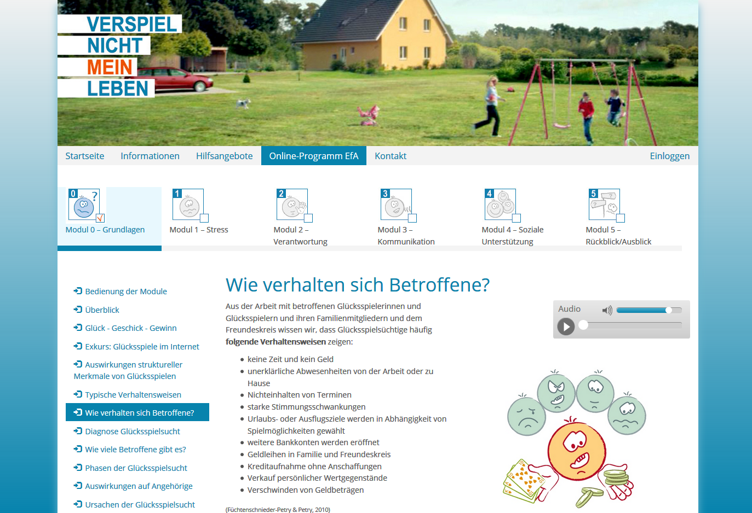
www.verspiel-nicht-mein-leben.de [Don‘t gamble away my life]

Slide 5
Self-help on the Internet
Module 0 Basic Knowledge
Module 1 Stress & Coping
Module 2 Responsibility & Accountability
Module 3 Communication
Module 4 Social Support
Module 5 Review & Future Planing
6 self-administered modules: 1 information module (unrestricted access) + 5 training modules (registration)

Slide 6
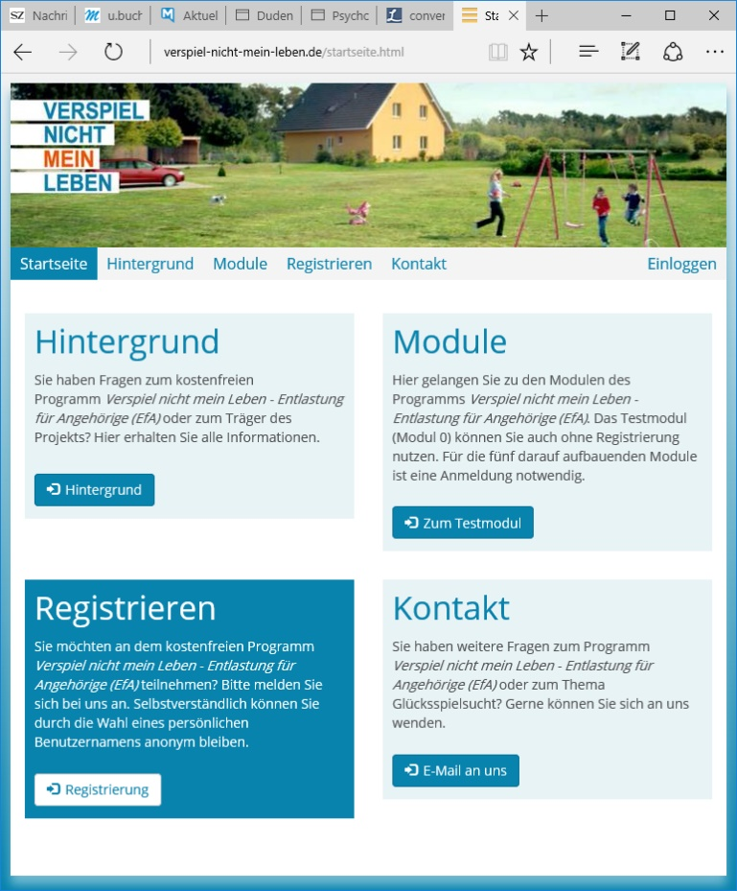
Method
Data collection 06/13-06/16
All participants (n=387):
Clinical Psychological Diagnostic System (Klinisch-Psychologisches Diagnosesystem 38; KPD; Percevic et al., 2005)
“2. Wave” (58%; 225 participants):
Action-specific aspects of perceived self-efficacy
Short questionnaire for family members affected by addiction (SSQFM-AA)
Notes:
KPD: 3 problem areas (General physical condition, Psychological impairment, social problems); 3 protective factors (competence skills, general life satisfaction, social support)

Slide 7
Participants‘ Characteristics
Age 18-69 years (mean 38.0; SD 11.7)
Gender 89.1% female; 10.9% male
Relationship to gambler 68.2% partners; 13.4% parents, 18.3% other AFMS (children, friends, siblings, aunts/uncles…)
Living with gambler 36.7% no joint household; 63.3% joint household
Prior support or self-help 65.4% no prior support or self help; 34.6% at least one time contact to support or self-help
Notes:
All participants

Slide 8
Current Well-Being (KPD-38; Percevic et al., 2005)
n=90 | Adherers (Start) | Adherers (End)
 | M (SD) | M (SD) | d | p
Global Scale | 2,66 (0,42) | 2,63 (0,47) | .07 | .705
Global Assessment of General Physical Condition | 2,57 (0,77) | 2,43 (0,83) | .18 | .068
Psychological Impairment | 2,78 (0,48) | 2,77 (0,53) | .02 | .844
Social Problems | 2,51 (0,53) | 2,55 (0,56) | -.07 | .344
Competence Skills | 2,51 (0,48) | 2,47 (0,56) | .08 | .212
General Life Satisfaction | 3,07 (0,65) | 2,94 (0,67) | .20 | .031*
Social Support | 1,95 (0,80) | 1,92 (0,81) | .04 | .539
Lower scores indicate less impairment, less problems, more resources, and more satisfaction.
Notes:
Clinical Psychological Diagnostic System (Klinisch-Psychologisches Diagnosesystem 38; KPD; Percevic et al., 2005)
38 items assessing current well-being → high internal consistency with good construct and criterion validity
Skalen 1-4; niedrigere Werte haben positive Valenz (weniger Beschwerden und Probleme, mehr Ressourcen, mehr Zufriedenheit).
Wilcoxon Test; small effect size

Slide 9
Perceived Self-Efficacy
On a scale from 1 to 5 (1=very confident; 5= not confident at all): How confident are you to be able … | All Parti-cipants (Start) n=225 | Adherers (Start) n=39 | Adherers (End) n=39
 | M (SD) | M (SD) | M (SD) | d | p
(1) To talk to the gambler about the situation | 2,71 (1,24) | 2,54 (1,23) | 2,21 (1,22) | .27 | .052
(2) To talk to your family and friends about the situation | 2,80 (1,20) | 2,77 (1,25) | 2,21 (1,06) | .48 | .035*
(3) To better cope with the stress due to the disordered gambling | 3,12 (1,15) | 2,79 (1,15) | 2,28 (0,89) | .50 | .012*
(4) To set your boundaries | 3,06 (2,53) | 2,82 (1,02) | 2,44 (0,97) | .38 | .021*
(5) To help the gambler on his/her path to recovery | 2,53 (1,11) | 2,74 (1,12) | 2,59 (1,02) | .14 | .359
Notes:
D effect size (Cohen's d); Wilcoxon-Test
Small to medium effect size (→ small: 0,2-0,5; medium: 0,5-0,8; big: >0.8)

Slide 10
Conclusion
Self-help on the Internet offers low threshold support for AFMs
Participants in EfA show positive changes
Self-help on the Internet can be an important addition to existing local services
But:
How can we make AFMs aware of online programmes?
How do AFMs know which programmes and informations on the Internet they can trust?

